Slide 1
Your task is to report when you have felt a gentle touch on your middle fingers. These tactile stimuli will be delivered to your left and right middle fingers using blunt plastic screws that rest inside the boxes sitting in front of you. Please be careful to NOT press down with any force on the plastic screws—simply rest your fingers on them so that you can feel them.
At the beginning of each trial, you will be presented with either a left or right arrow in the middle of the computer screen:
OR
Press the left foot pedal to continue…

Slide 2
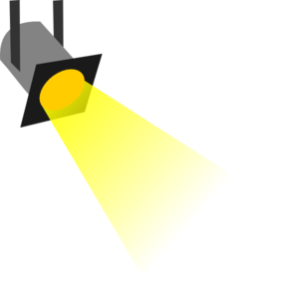
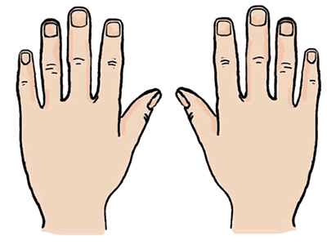
A left arrow indicates that a tactile stimulus may or may not be delivered to your left middle finger. When you see a left arrow, please direct your attention to only your left middle finger.
Press the left foot pedal to continue…

Slide 3
A right arrow indicates that a tactile stimulus may or may not be delivered to your right middle finger. When you see a right arrow, please direct your attention to only your right middle finger.
Press the left foot pedal to continue…

Slide 4
When the arrow disappears, a green fixation cross will then appear:
When you see the green cross, please indicate whether or not you felt a touch on your finger by using the foot pedals to respond.
Press the left foot pedal for “yes” (if you felt a touch) and the right foot pedal for “no” (if you did NOT feel a touch). You will have up to 1.5 seconds to respond. Responses are ONLY recorded during the green cross.
Press the left foot pedal to continue…

Slide 5
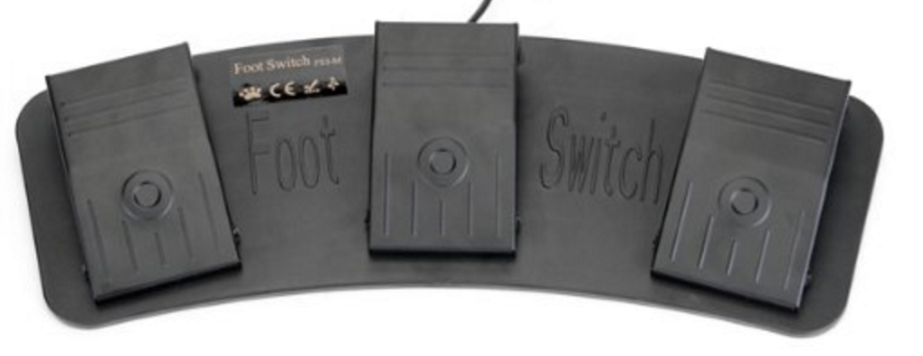
YES
NO
Press the left foot pedal to continue…

Slide 6
Again, remember that you cannot respond until the green cross appears on the screen.
We ask that you do your best to not blink until the green cross is presented. That is, try not to blink while an arrow appears on the screen. Please also do your best to remain as still as possible throughout the task, without moving your arms and legs.
Please let the experimenter know if you have any questions or if you experience any discomfort at any point during the experiment.
Press the left foot pedal to continue…

Slide 7
There will now be a short practice session to help you become familiar with the task.
Press the left foot pedal to begin Practice Session 1…

Slide 8
Practice Session 1 has now ended.
Please inform the experimenter if you have any questions about the task or if you need further clarification on what to do. Next we will calculate your touch detection thresholds for your left and right middle fingers.
Press the left foot pedal to continue…

Slide 9
First you will be presented with tactile stimuli to your left middle finger only. This is done in order to calculate how well you are able to perceive touches on your left middle finger. This is your detection threshold.
As before, you will be presented with blue arrows and green crosses. This time, you will only see left arrows, so please pay attention to your left finger only. When you see a green cross, please indicate whether you felt a touch on your left finger. Again, press the left foot pedal for “yes” and the right foot pedal for “no”.
Press the left foot pedal to begin the threshold procedure for your left finger…

Slide 10
We have now calculated your touch detection threshold for your left finger.
When you are ready, we will begin the threshold procedure for your right middle finger. This time, you will only see right arrows, so please pay attention to your right finger only. When you see a green cross, please indicate whether you felt a touch on your right finger using the foot pedals.
Press the left foot pedal to begin the threshold procedure for your right finger…

Slide 11
We have now calculated your touch detection threshold for your right finger.
There will now be another short practice session to help you become more familiar with the task. This time the trials will move a little more quickly compared to Practice Session 1, and the touches to your middle fingers will be even more gentle.
Press the left foot pedal to begin Practice Session 2…

Slide 12
Practice Session 2 has now ended. Please inform the experimenter if you have any questions about the task.
Press the left foot pedal to continue…

Slide 13
When you are ready, we will begin the task. The task should last at most 20 minutes, with 3 breaks along the way.
Please remember to do your best to blink only during the green cross and not during the arrows. Please also remember to sit as still as possible without moving your arms and legs while the task is in progress. Before you begin, make sure you are in a comfortable position, and give yourself a few moments to become still.
Press the left foot pedal when you are ready to begin the task…

Slide 14
You have completed the experimental session. Thank you for your time. Please let the experimenters know you are finished.
Press the left foot pedal to end this task…

Slide 20
Practice Session 1 has now ended. Please wait for the experimenter before continuing.

Slide 21
Practice Session 2 has now ended. Please wait for the experimenter before continuing.

Slide 22
You will now have a 60 second break in the task.
Please try to remain as still as possible, as it can disrupt the sensors on the EEG cap, but feel free to make small adjustments in your posture to be more comfortable.
Another screen will alert you when you have 10 seconds remaining.
If you would like to continue with the task before the break is over, press the left foot pedal…

Slide 23
You have 10 seconds remaining in the break. Please be as still as possible. The task will resume automatically…

